Slide 1
Software and Software Engineering

Slide 2
What is a Software?
Software is:
(1) instructions (computer programs) that when executed provide desired features, function, and performance;
(2) data structures that enable the programs to adequately manipulate information and
(3) documentation that describes the operation and use of the programs.

Slide 3
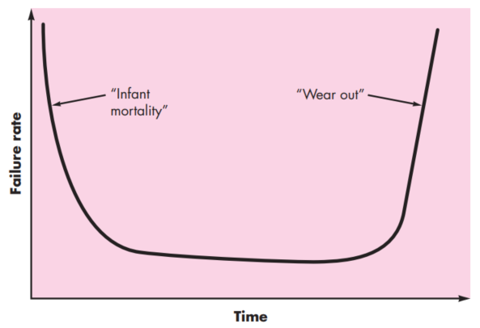
What is a Software?
Software is developed or engineered, it is not manufactured in the classical sense.
Software doesn't "wear out." It deteriorates
Failure rate against time for hardware -->

Slide 4
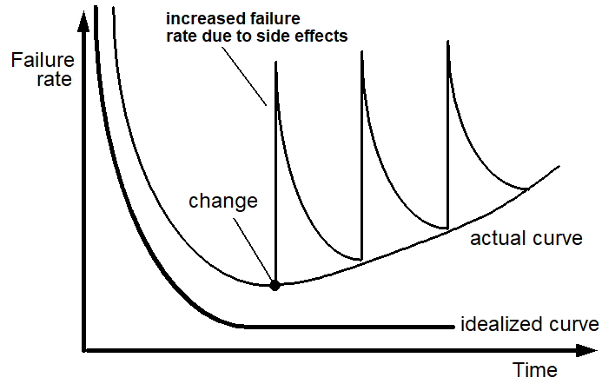
Wear vs Deterioration

Slide 5
What is a Software?
Generic products
Stand-alone systems that are marketed and sold to any customer who wishes to buy them.
Examples – PC software such as editing, graphics programs, project management tools; CAD software; software for specific markets such as appointments systems for dentists.
Customized products
Software that is commissioned by a specific customer to meet their own needs.
Examples – embedded control systems, air traffic control software, traffic monitoring systems.

Slide 6
Software costs
Software costs often dominate computer system costs. The costs of software on a PC are often greater than the hardware cost.
Software costs more to maintain than it does to develop. For systems with a long life, maintenance costs may be several times development costs.
Software engineering is concerned with cost-effective software development.

Slide 7
Software Applications
System software - Software involving heavy interaction with hardware written to service other program. Ex - compilers, editors, and file management utilities, operating system components, drivers, etc.
Application software - Stand-alone programs that solve a specific business need
Engineering/scientific software - has been characterized by “number crunching” algorithms. Applications range from astronomy to volcanology, from automotive stress analysis to space shuttle orbital dynamics, and from molecular biology to automated manufacturing.
Softwares and Software Myths

Slide 8
Software Applications
Embedded software - resides within a product or system and is used to implement and control features and functions for the end user and for the system itself. Ex - Microwave oven, elevator, etc.
Product-line software - designed to provide a specific capability for use by many different customers. Ex- Word processing software, etc.
WebApps (Web applications) - Program that is stored on a remote server and delivered over the Internet through a browser interface. Ex: Facebook, Youtube, etc.
AI software

Slide 9
Legacy Software
Legacy software systems were developed decades ago and have been continually modified to meet changes in business requirements and computing platforms.
The proliferation of such systems is causing headaches for large organizations who find them costly to maintain and risky to evolve.
Many legacy systems remain supportive to core business functions and are ‘indispensable’ to the business.
But legacy softwares are often of very poor quality.

Slide 10
Legacy Software
Why must it change?
software must be adapted to meet the needs of new computing environments or technology.
software must be enhanced to implement new business requirements.
software must be extended to make it interoperable with other more modern systems or databases.
software must be re-architected to make it viable within a network environment.

Slide 11
Software Engineering

Slide 12
Software Engineering
In order to build software that is ready to meet the challenges of the twenty-first century, you must recognize a few simple realities:
a concerted effort should be made to understand the problem before a software solution is developed
design becomes a pivotal activity
software should exhibit high quality
software should be maintainable
The seminal definition: The establishment and use of sound engineering principles in order to obtain economically software that is reliable and works efficiently on real machines.

Slide 13
Software Engineering
The IEEE definition:
Software Engineering:
(1) The application of a systematic, disciplined, quantifiable approach to the development, operation, and maintenance of software; that is, the application of engineering to software.
(2) The study of approaches as in (1).

Slide 14
Videos:
What is software engineering anyway?
Software Engineering
Software Art Thou: Glenn Vanderburg - Real Software Engineering

Slide 15
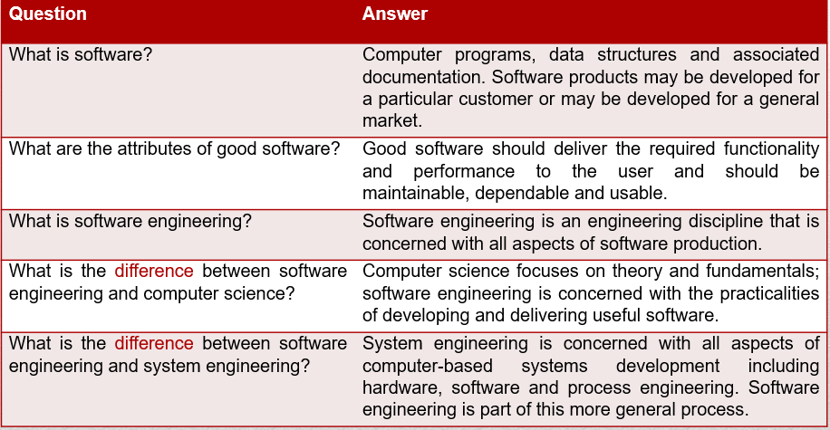
FAQ About Software Engineering

Slide 16
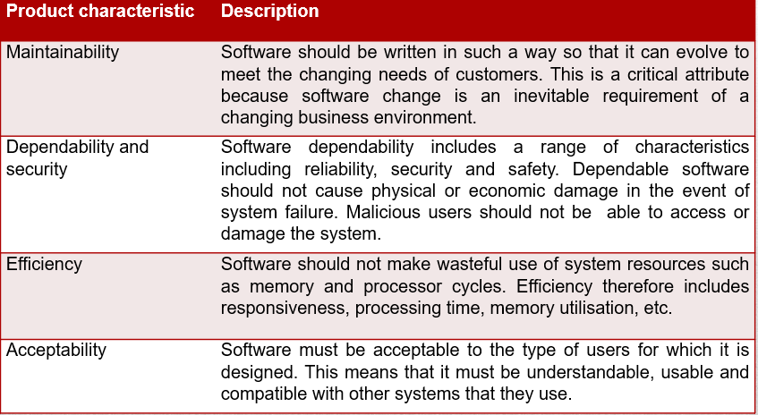
Essential attributes of good software

Slide 17
Practicing Software Engineering

Slide 18
The Essence of Practice
In the classic book, How to Solve It, written before modern computers existed, George Polya outlined the essence of problem solving, and consequently, the essence of software engineering practice:
1. Understand the problem (communication and analysis).
2. Plan a solution (modeling and software design).
3. Carry out the plan (code generation).
4. Examine the result for accuracy (testing and quality assurance).

Slide 19
Understanding the problem
Who has a stake in the solution to the problem? That is, who are the stakeholders?
What are the unknowns? What data, functions, and features are required to properly solve the problem?
Can the problem be compartmentalized? Is it possible to represent smaller problems that may be easier to understand?
Can the problem be represented graphically? Can an analysis model be created?

Slide 20
Plan the Solution
Have you seen similar problems before? Are there patterns that are recognizable in a potential solution? Is there existing software that implements the data, functions, and features that are required?
Has a similar problem been solved? If so, are elements of the solution reusable?
Can subproblems be defined? If so, are solutions readily apparent for the subproblems?
Can you represent a solution in a manner that leads to effective implementation? Can a design model be created?

Slide 21
Carry out the plan
Does the solution conform to the plan? Is source code traceable to the design model?
Is each component part of the solution provably correct? Has the design and code been reviewed, or better, have correctness proofs been applied to algorithm?

Slide 22
Examine the Result
Is it possible to test each component part of the solution? Has a reasonable testing strategy been implemented?
Does the solution produce results that conform to the data, functions, and features that are required? Has the software been validated against all stakeholder requirements?

Slide 23
David Hooker’s General Principles
1: The Reason It All Exists - A software system exists for one reason: to provide value to its users. Before specifying a requirement, ask yourself questions such as: “Does this add real value to the system?” If the answer is no, don’t do it. All other principles support this one.
2: KISS (Keep It Simple, Stupid!) - All design should be as simple as possible, but no simpler.
3: Maintain the Vision - A clear vision is essential to the success of a software project. Without one, a project almost unfailingly ends up being “of two [or more] minds” about itself.

Slide 24
David Hooker’s General Principles
4: What You Produce, Others Will Consume - In some way or other, someone else will use, maintain, document, or otherwise depend on being able to understand your system. So, always specify, design, and implement knowing someone else will have to understand what you are doing.
5: Be Open to the Future - Change is inevitable for a software. So softwares must be able to cope up with future changes.
6: Plan Ahead for Reuse
7: Think! Placing clear, complete thought before action almost always produces better results.

Slide 25
Software Myths
Affect managers, customers (and other non-technical stakeholders) and practitioners
Are believable because they often have elements of truth,
but …
Invariably lead to bad decisions,
therefore …
Insist on reality as you navigate your way through software engineering

Slide 26
Software Myths

Slide 27
Software Myths - Practitioner’s myth
Myth 1: Once we write the program and get it to work, our job is done.
Reality: the sooner you begin writing code, the longer it will take you to get done. 60% to 80% of all efforts are spent after software is delivered to the customer for the first time.
Myth 2: Until I get the program running, I have no way of assessing its quality.
Reality: technical review are a quality filter that can be used to find certain classes of software defects from the inception of a project.

Slide 28
Software Myths - Practitioner’s myth
Myth 3: software engineering will make us create voluminous and unnecessary documentation and will invariably slow us down.
Reality: it is not about creating documents. It is about creating a quality product. Better quality leads to a reduced rework. Reduced work results in faster delivery times.
Many people recognize the fallacy of the myths. Regrettably, habitual attitudes and methods foster poor management and technical practices, even when reality dictates a better approach.

Slide 29
Software Myths - Manager’s myth
Myth 4: More people always mean the job will be done quicker.
Reality: Software development is not a mechanistic process like manufacturing.
As new people are added, people who were working must spend time educating the newcomers, thereby reducing the amount of time spent on the productive development effort.
People can be added but only in a planned and well-coordinated manner

Slide 30
Software Myths - Manager’s myth
Myth 5: We already have a book that's full of standards and procedures for building software. Won't that provide my people with everything they need to know?
Reality: The book of standards may very well exist, but is it used? Are software practitioners aware of its existence? Does it reflect modern software engineering practice? Is it complete? Is it adaptable? Is it streamlined to improve time-to-delivery while still maintaining a focus on quality? In many cases, the answer to all of these questions is no

Slide 31
Software Myths - Customer’s myth
Myth 6: A general statement of objectives is sufficient to begin writing programs—we can fill in the details later
Reality: Although a comprehensive and stable statement of requirements is not always possible, an ambiguous “statement of objectives” is a recipe for disaster.
Unambiguous requirements (usually derived iteratively) are developed only through effective and continuous communication between customer and developer.

Slide 32
Software Myths - Customer’s myth
Myth 7: Software requirements continually change, but change can be easily accommodated because software is flexible.
Reality: It is true that software requirements change, but the impact of change varies with the time at which it is introduced.
When requirements changes are requested early (before design or code has been started), the cost impact is relatively small. However, as time passes, the cost impact grows rapidly— resources have been committed, a design framework has been established, and change can cause upheaval that requires additional resources and major design modification.

Slide 33
How It All Starts
Every software project is precipitated by some business need—
the need to correct a defect in an existing application;
the need to the need to adapt a ‘legacy system’ to a changing business environment;
the need to extend the functions and features of an existing application, or
the need to create a new product, service, or system.

Slide 34
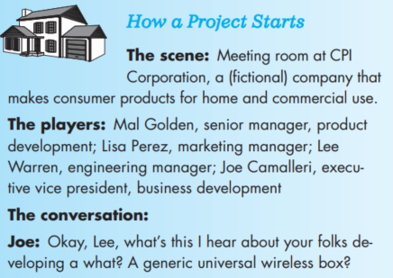
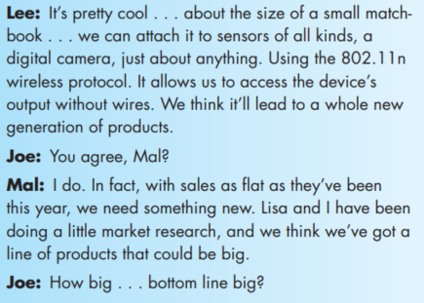
How It All Starts
SafeHome:
Every software project is precipitated by some business need—
the need to correct a defect in an existing application;
the need to the need to adapt a ‘legacy system’ to a changing business environment;
the need to extend the functions and features of an existing application, or
the need to create a new product, service, or system.

Slide 35
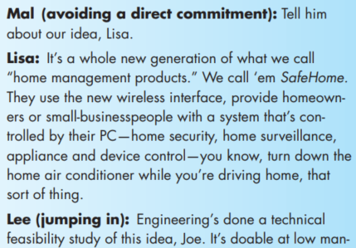
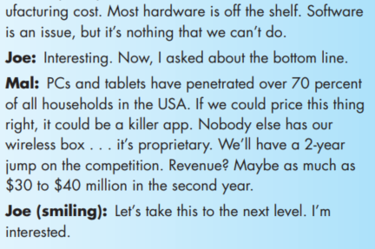
How It All Starts
SafeHome:
Every software project is precipitated by some business need—
the need to correct a defect in an existing application;
the need to the need to adapt a ‘legacy system’ to a changing business environment;
the need to extend the functions and features of an existing application, or
the need to create a new product, service, or system.

Slide 36
Discussion & Debate

Slide 37
Discussion & Debate
Provide a number of examples (both positive and negative) that indicate the impact of software on our society
Many modern applications change frequently—before they are presented to the end user and then after the first version has been put into use. Suggest a few ways to build software to stop deterioration due to change.
As software becomes more pervasive, risks to the public (due to faulty programs) become an increasingly significant concern. Develop a doomsday but realistic scenario in which the failure of a computer program could do great harm (either economic or human).

Slide 38
Discussion & Debate
Add two additional myths to the list presented in this lecture. Also state the reality that accompanies the myth.

Slide 39
Discussion & Debate
Answer the following questions -
Why does it take so long to get software finished?
Why are development costs so high?
Why can’t we find all errors before we give the software to our customers?
Why do we spend so much time and effort maintaining existing programs?
Why do we continue to have difficulty in measuring progress as software is being developed and maintained?

Slide 40
Thank you!

